Slide 1
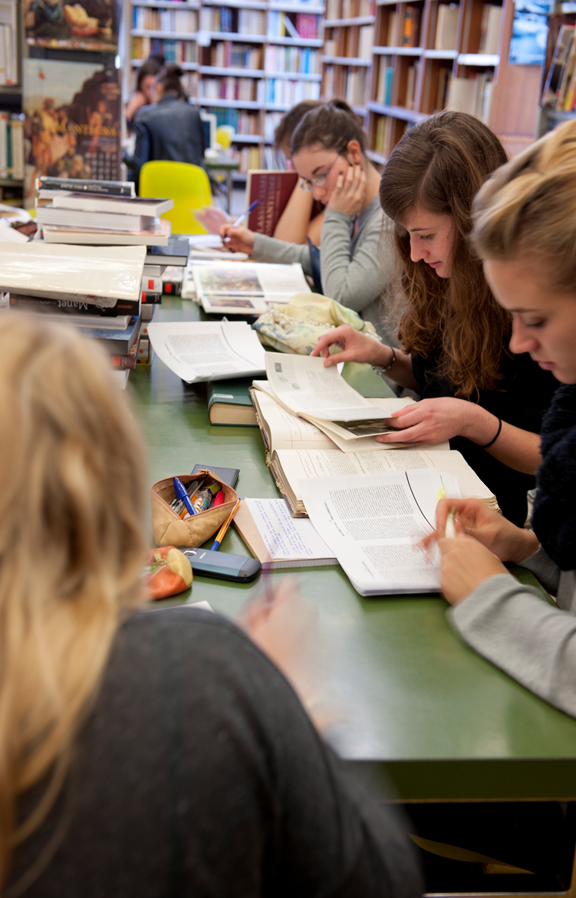
Car
Psychology in Tours
Dr Caroline Giraudeau - Lecturer - EAIE 2019 - Helsinki
caroline.giraudeau@univ-tours.fr

Slide 2
Psychology in Tours
A few statistics:
- 600 students in the first year of the bachelor's degree
- 300 students in the second year
- 200 students in the third year
- 100 students in the first year of the Master's degree
- 100 students in the second year of the Master's degree
- 30 PhD students
40 professor-researchers
4 secretaries
3 research ingeneers

Slide 3
Psychology in Tours
First year of their bachelor's degree
General presentation of Psychology
Initiation to related fields (biology, philosophy,
sociology)
Training in university working methods
Teaching statistics and English
Reflection about the career plan

Slide 4
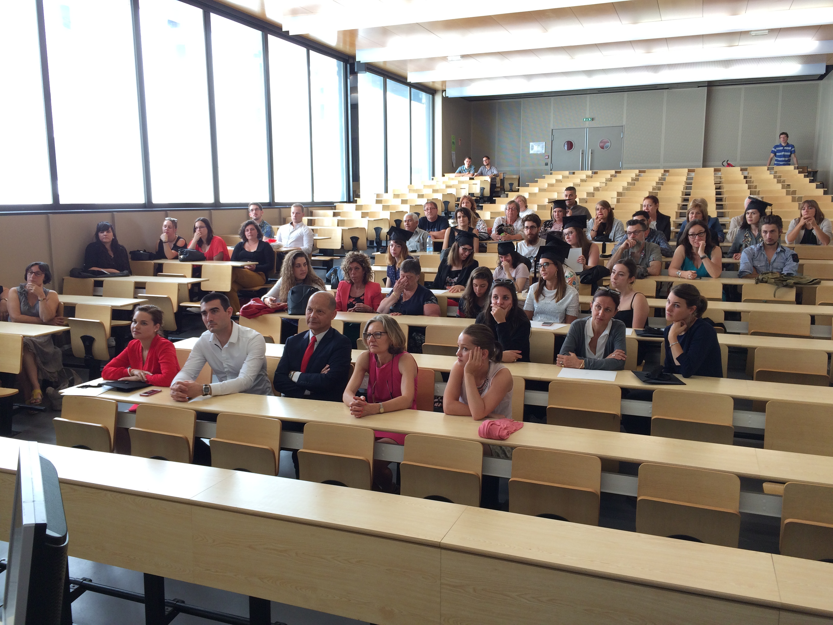
Psychology in Tours
Second year of the bachelor's degree
Cognitive psychology
Developmental psychology
Psychobiology
Social psychology
Gerontological psychology
Statistics
English
Work psychology
Clinical psychology

Slide 5
Psychology in Tours
Second year of the bachelor's degree
Introduction to social psychology
Developmental psychology
Cognitive psychology
Clinicat psychology
Principal of satistic analysis
Opening courses…

Slide 6
Psychology in Tours
Third year of the bachelor's degree
Ability to choose and further develop in a field of psychology
Cognitive psychology
Psychobiology
Cognitive psychology
Psychobiology
Cognitive psychology
Psychobiology
Social psychology
Gerontological psychology
Statistics
Social psychology
Gerontological psychology
Statistics
Social psychology
Gerontological psychology
Statistics
English
Work psychology
Clinical psychology
English
Work psychology
Clinical psychology
English
Work psychology
Clinical psychology

Slide 7
Psychology in Tours
Third year of the bachelor's degree
Social psychology
Developmental psychology
Cognitive psychology
Clinical psychology
Psychobiology
Geropsychology
Options…..

Slide 8
Psychology in Tours
Master's degree
One diploma oriented towards Research: Cognition and Neurosciences
Four vocational diplomas:
Psychology of Work and Organizations
Psychopathology and Clinical Psychology
Child and Adolescent Psychology
Normal and Pathological Gerontological Psychology

Slide 9
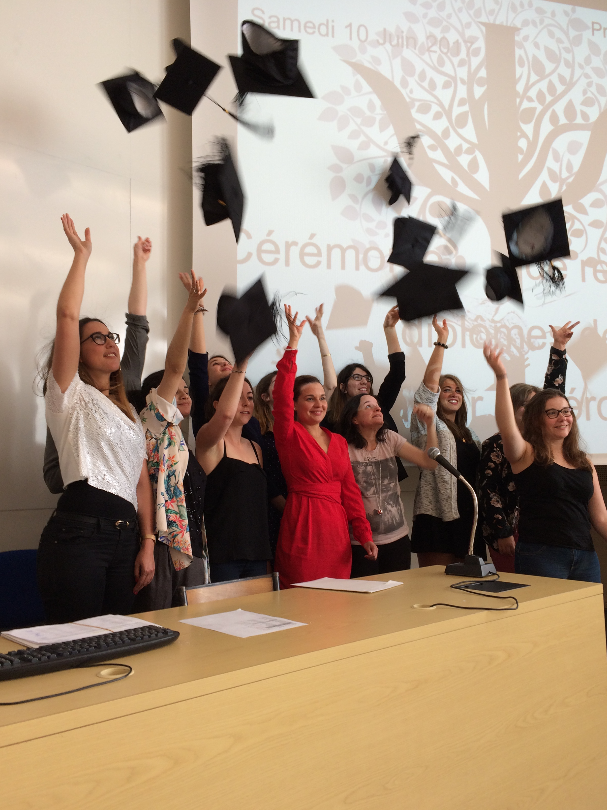
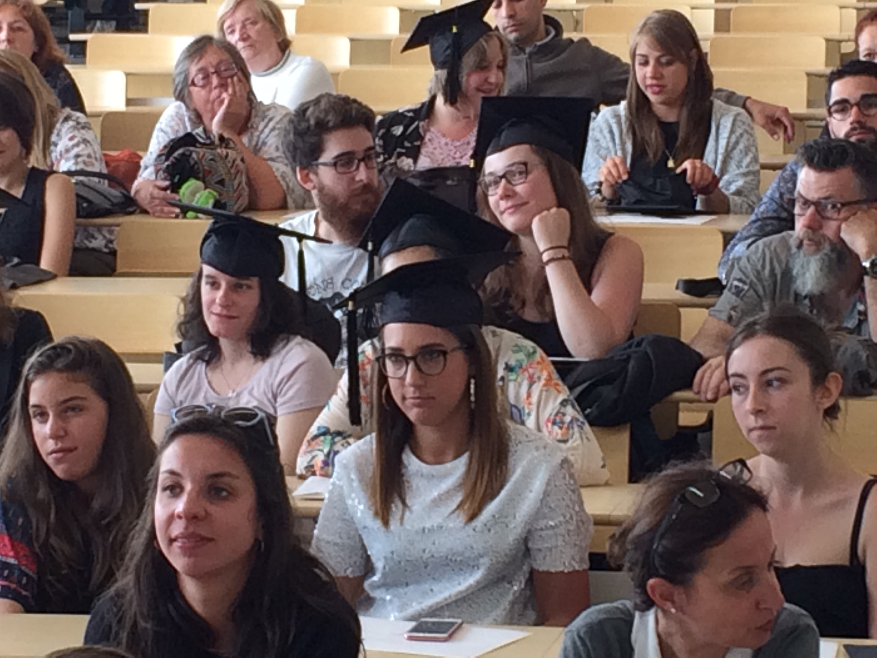
Psychology in Tours
Master's degree

Slide 10
Psychology in Tours
2 semesters:
from early September to mid-December,
then from January to April
+/- 20 hours of classes per week from Monday 8am to Saturday 12pm.
Teaching in auditoriums (+/- 250 students), classrooms (45 students) and labrooms (25 students)
Evaluation:
Continuous testing and
End examinations (CM)

Slide 11
Exchange students
Psychology in Tours

Slide 12
Exchange students
Supervised project !
Psychology in Tours
Exchange students can apply for a supervised project in our labs :
The project is carried out in a laboratory under the supervision of a lecturer, assistant professor or professor. The students will be examined by an oral presentation, a written report and a theory test.
Students can validate 15 ECTS at Bachelor level or 20 ECTS at Master level during the semester.
Students can complete their learning agreement with CUEFEE’s French courses for foreign students (up to 8-12 ECTS) and with disciplinary courses -> http://cces.univ-tours.fr/

Slide 13
Exchange students
Learning Agreement
Psychology in Tours
Supervised project
15 ECTS at Bachelor level or 20 ECTS at Master level during the semester.
CUEFEE’s French courses for foreign students
(up to 8-12 ECTS)
Disciplinary courses -> http://cces.univ-tours.fr/
Histoire de Jazz ( 2 ECTS)
Tender and the law (3 ECTS)

Slide 14
Psychology in Tours
RESEARCH
University of Tours

Slide 15
University of Tours
PSYCHOLOGY
LABORATORY
Development, and cognitive, emotional and social adjustment
Emotions
ToM
Gerontology and daily life
Food
Physical exercise and ageing

Slide 16
University of Tours
PSYCHOLOGY
LABORATORY
▪ Individual development from childhood to old age
▪ Memory
▪ Language
▪ Communication
▪ Social regulation of cognitive functions
▪ Relations between physical exercise and cognition
Centre de Recherches sur la Cognition et l’Apprentissage

Slide 17
University of Tours
PSYCHOLOGY
LABORATORY
Psychological health, work and quality of life

Slide 18
University of Tours
PSYCHOLOGY LABORATORIES Presentation
Linked to the Doctoral School “Social and Human Sciences”
Linked to the Psychology Department
Member of the “Maison des Sciences de l’Homme Val de Loire”

Slide 19
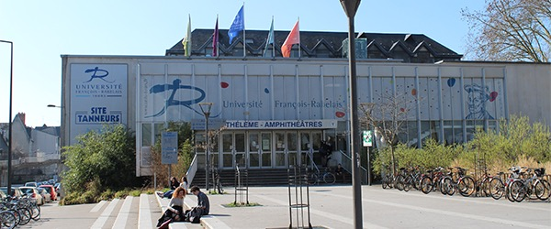
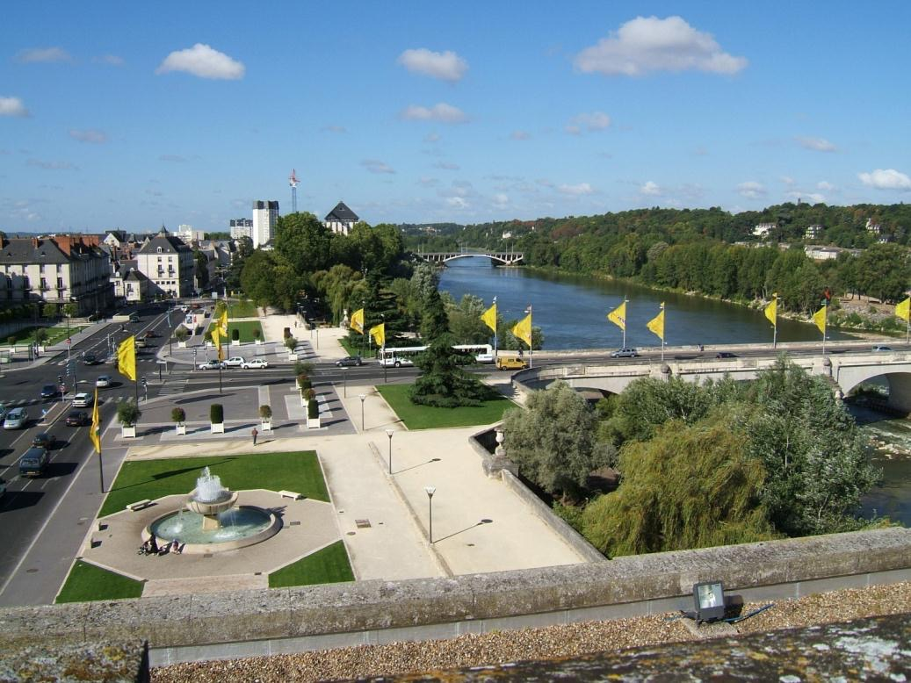
University of Tours
AT A GLANCE

Slide 20
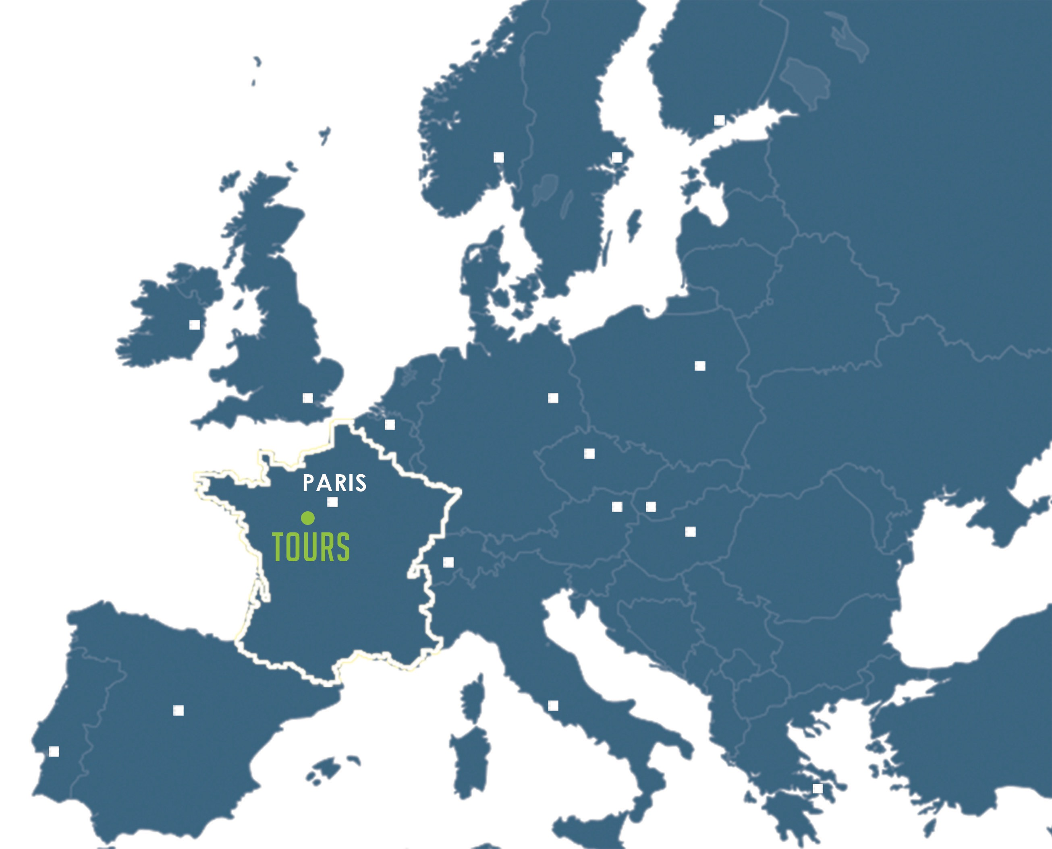
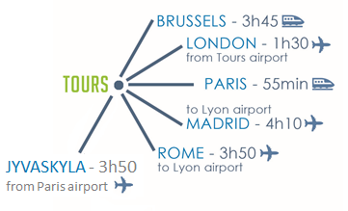
University of Tours
AT A GLANCE Location

Slide 21
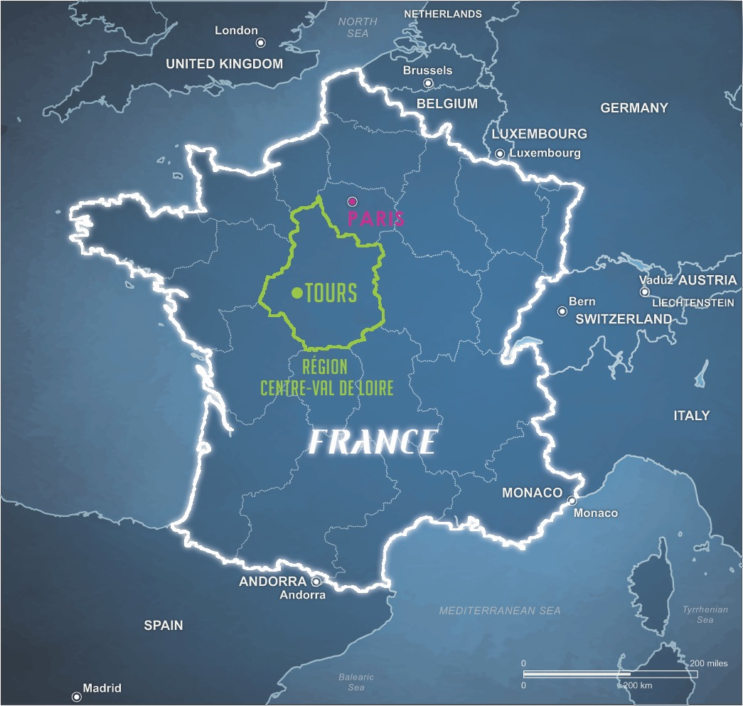
University of Tours
AT A GLANCE Location
A dynamic city located one hour from Paris by train
In the heart of the Loire Valley : « le Jardin de la France »
Known as the cradle of French language

Slide 22
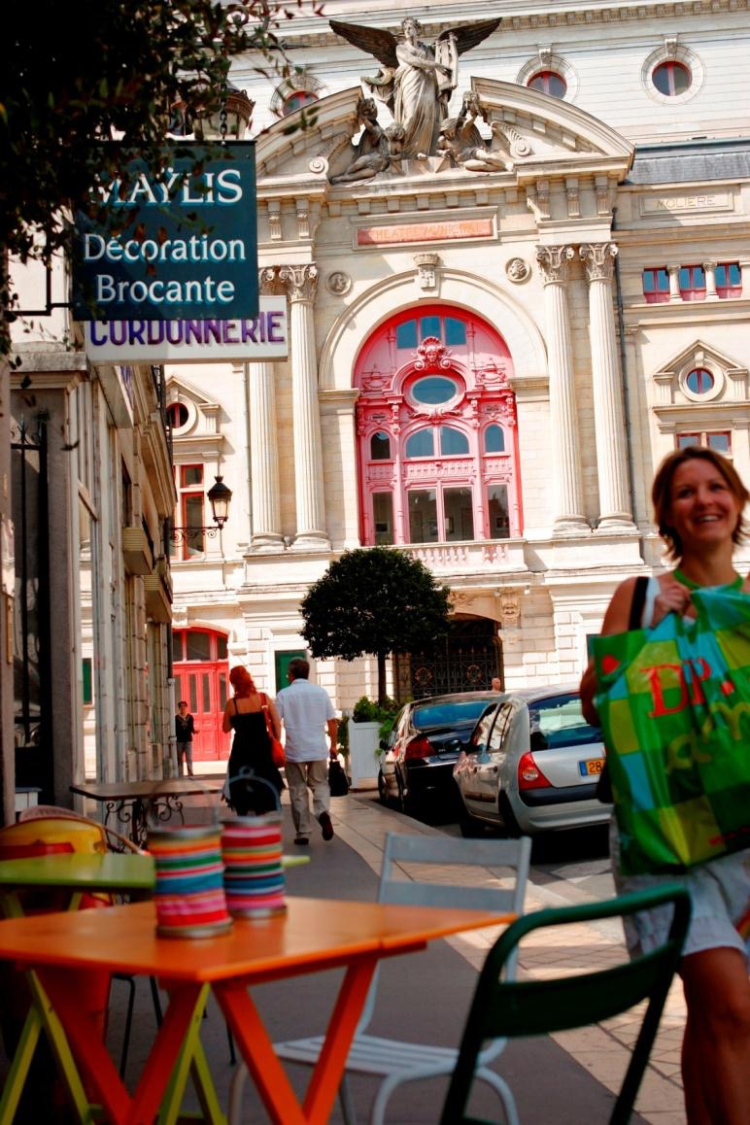
University of Tours
ABOUT THE CITY
OF TOURS

Slide 23
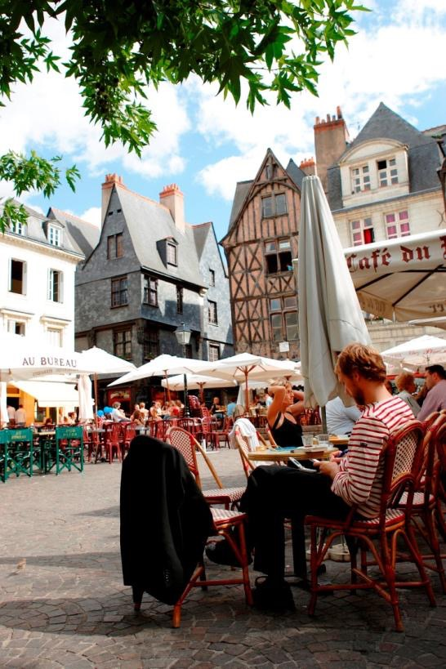
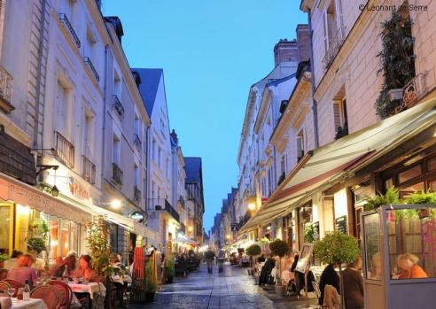
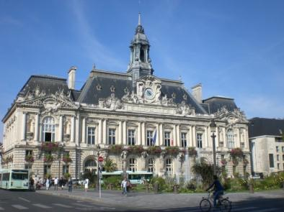
University of Tours
ABOUT THE CITY OF TOURS
A human-sized city
300,000 inhabitants
with over 26,000 students
40% of its people having less than 30 years old
1 hour from Paris by TGV
A city renowned worldwide
for its cuisine, its wines,
and « art de vivre »

Slide 24
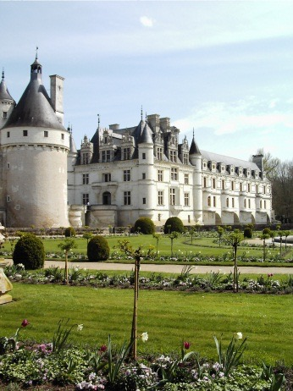
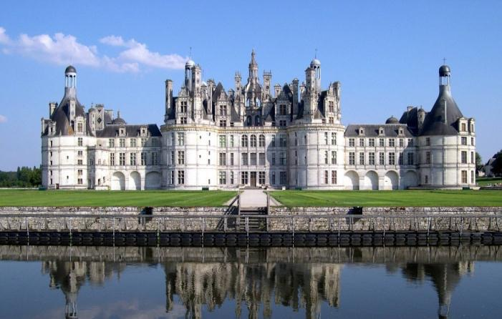
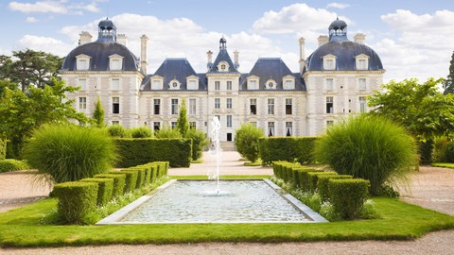
University of Tours
ABOUT THE CITY OF TOURS
The Capital of the Touraine area,
where the river Loire –
listed as UNESCO World Heritage - flows
Home to Rabelais, Leonardo da Vinci, Descartes, Ronsard, Balzac…
A modern enterprising city with a prestigious past (The Loire Valley and its Châteaux)

Slide 25
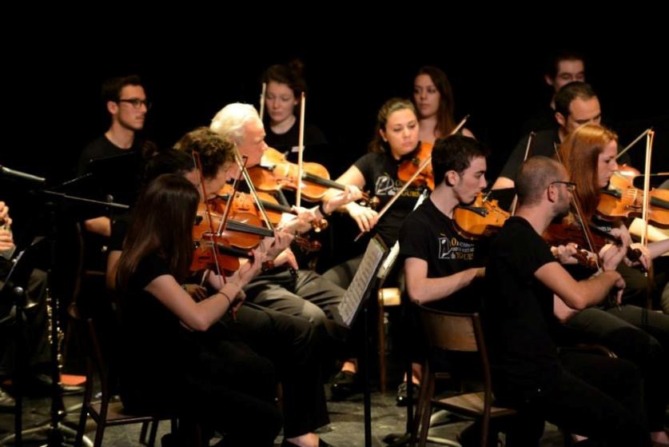
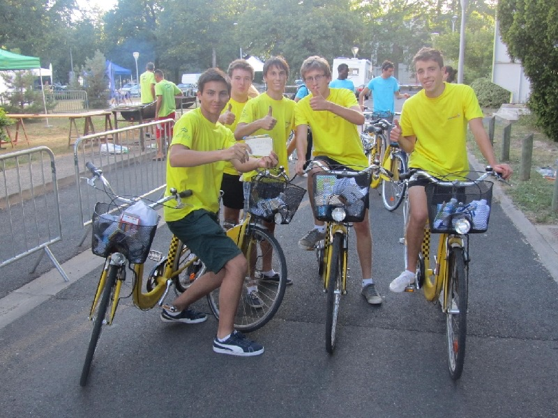
University of Tours
FACILITIES

Slide 26
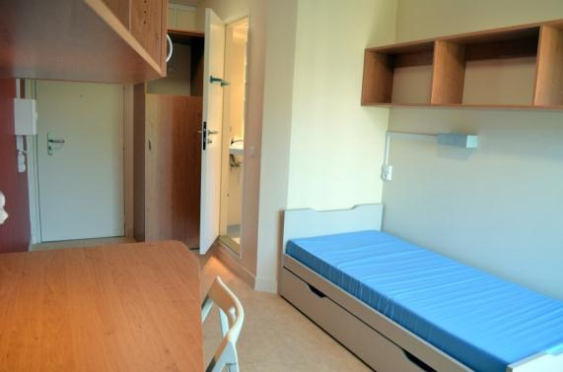
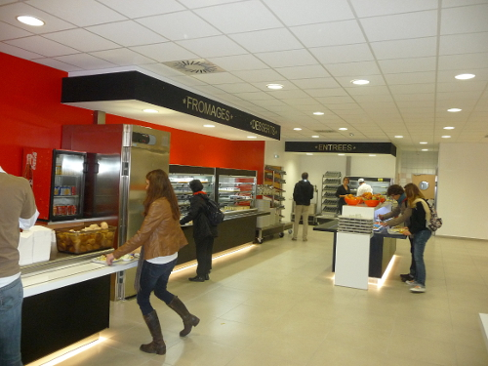
University of Tours
FACILITIES Food & Accommodation
University Accommodation
CROUS (national student service agency) offers rooms and studio apartments:
10 halls of residence
2 800 beds
From 170 to 410 Euros per month
Private housing in the city/with families
Food
15 University Restaurants
They offer a complete meal for 3,25 €

Slide 27
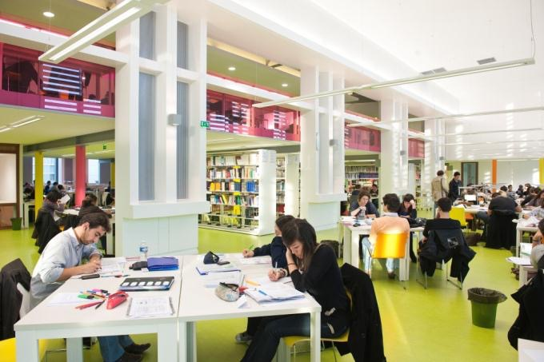
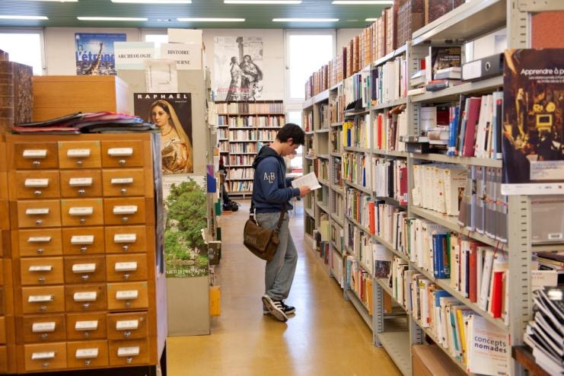
University of Tours
FACILITIES Culture
Libraries
A central university library offering over 600,000 titles
17 specialized research libraries

Slide 28
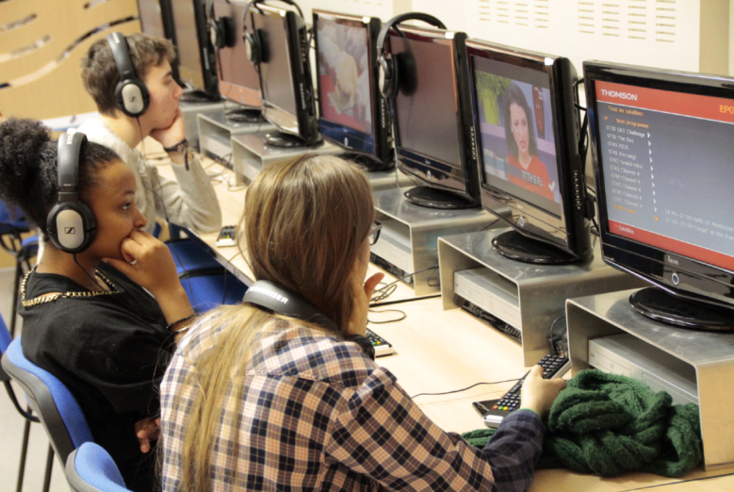
University of Tours
FACILITIES Culture
6 Language Resources Center (CRL)
Through its Language Resource Centers (CRL), the University provides students with a guided self-study system tailored to their academic, professional and personal needs and targets.
Softwares, books, movies and video materials, international magazines and TV channels are available so that any student can learn or improve a new language.

Slide 29
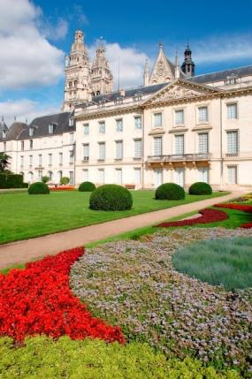
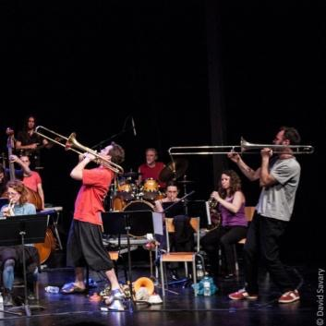
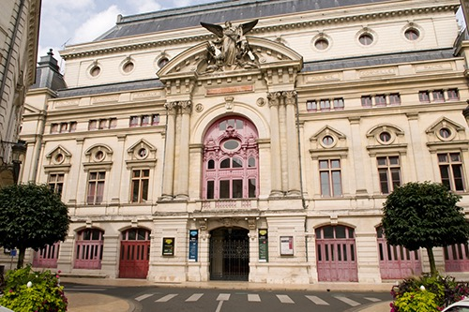
University of Tours
FACILITIES Culture
An intense Cultural & Social Life !
University “Passport to Cultural Experience”
which enables discount prices on to
50 of the town’s top cultural addresses!
50 artistic structures in and around Tours :
Museum of fine arts, Contemporary Creation Center, Regional Theater, Opera and Concert hall, Thélème (fully-equipped University Concert & Theatre auditorium sitting 600), …

Slide 30
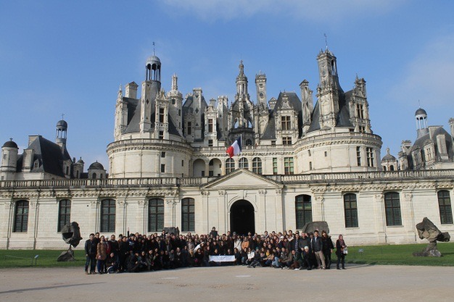
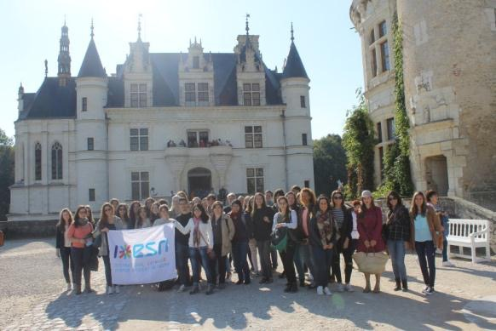
University of Tours
FACILITIES Culture
An intense Cultural & Social Life !
Cultural program and buddy system dedicated to exchange students
100 students’ associations
Including Erasmus Student Network Tours – an association intended for local and international students

Slide 31
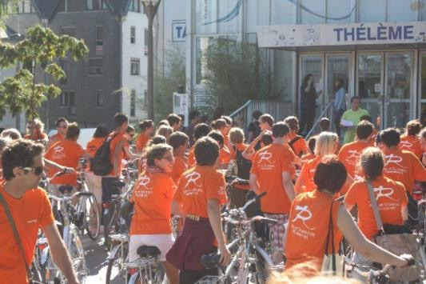
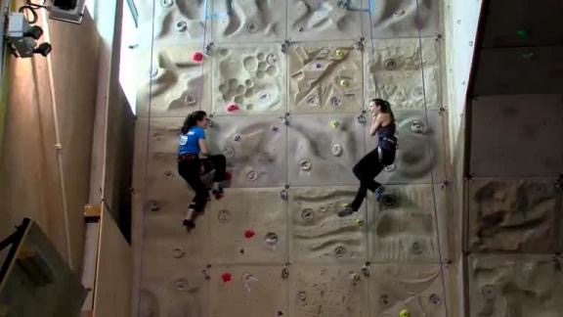
University of Tours
FACILITIES Sports
Sports
160 clubs and student societies in Tours
with over 33,000 members practicing
120 different sports in university facilities or in town
63 sporting activities on offer within the University structure
The Pack Sport card (25€) gives students access to this full range of activities. They can also benefit from the reduced rates proposed by the various local partner clubs.
Special arrangements available for high-level athletes

Slide 32
University of Tours
FACILITIES Medicine
A University Medical Office
A multidisciplinary team of doctors and nurses offer
free individual consultations :
General Practice
Dentistry
Psychology
Gynecology
Dermatology
Nutrition
Sports Medicine
A dedicated Office for disabled students
The « Mission Handicap » implements global and customized actions to take into account the student’s needs so that he/she can make the best of his/her studies and social life.

Slide 33
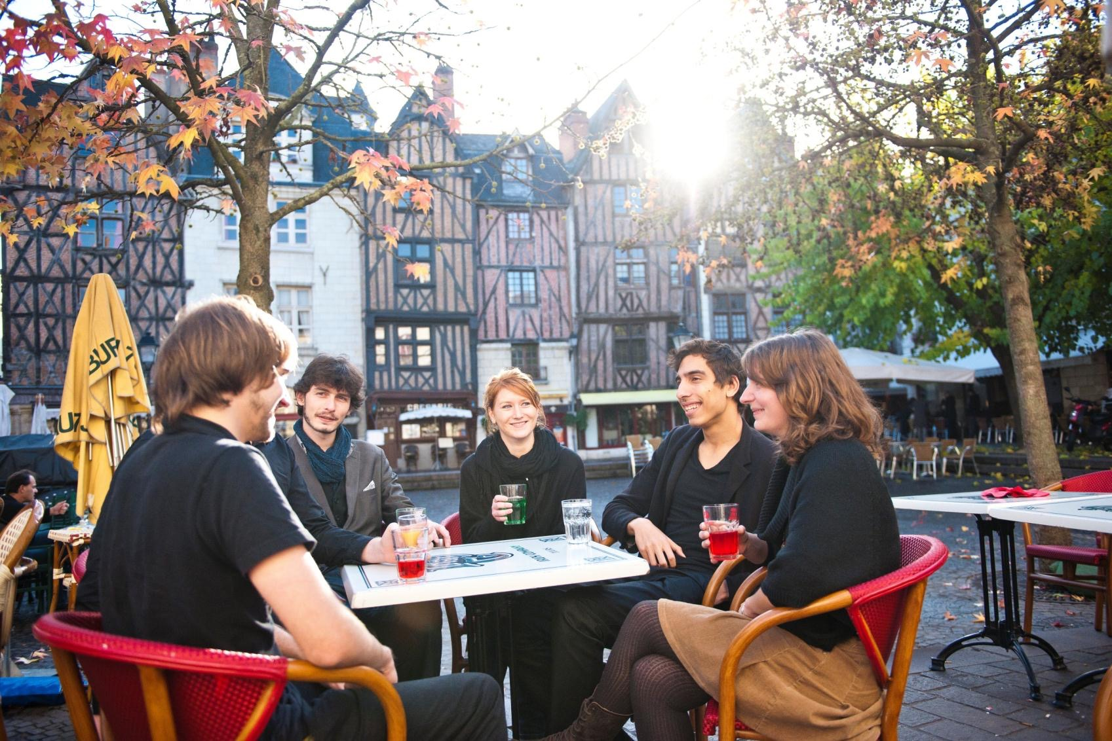
Cosmopolitan City of Learning !
See you soon in Tours
© DRI May 2016 - Updated November 2017

